Slide 1
Hadoop applications
Overview:
BigData
HADOOP
Hadoop in Software Industries
Ex. Google, Facebook , Twitter ,Amazon LinkedIn etc.
Applications:
Log and/or clickstream analysis of various kinds
Marketing analytics
Machine learning and/or sophisticated data mining
Image processing
Processing of XML messages
Web crawling and/or text processing
Graph Mining

Slide 2
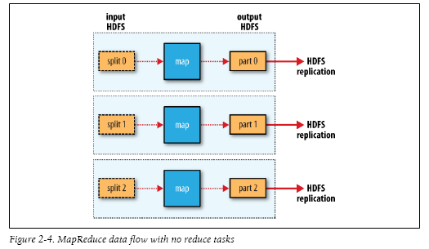
How HADOOP WORKS?

Slide 3
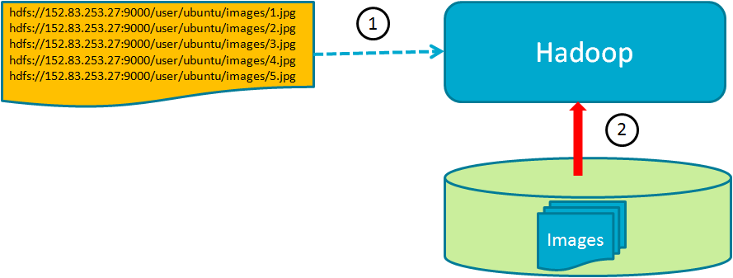
Image Processing Using Hadoop
1.Using HDFS (Hadoop Distributed File System)'s URL

Slide 4
Image Processing Using Hadoop
2. Using Hadoop Sequence File
Sync Marker :To ensure that a record is read in its entirety, even when the sequence file
is split in blocks across nodes in HDFS
Advantage :Reduces the overhead of launching and managing a large number of map tasks

Slide 5
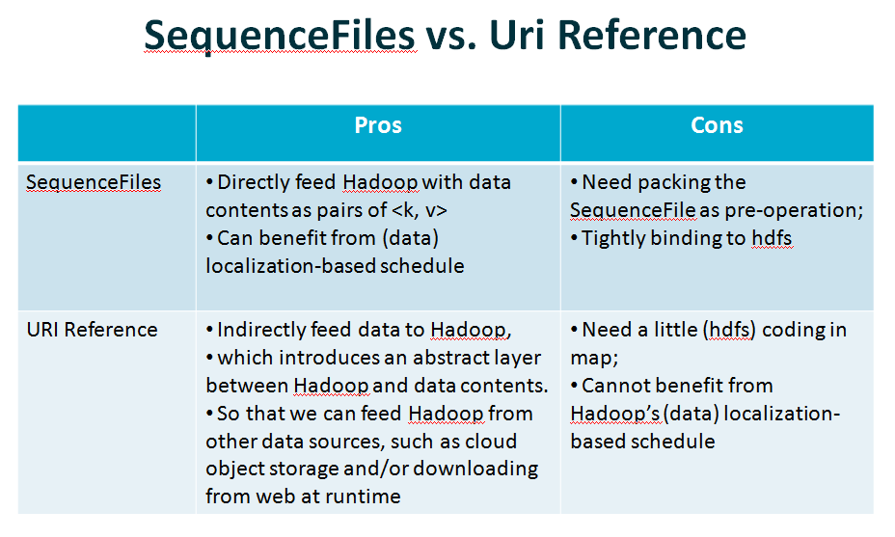
Image Processing Using Hadoop

Slide 6
Face Dtetection
Library Used: Javacv (Opencv)
Algorithm:
Step 1. Convert images you want to process to hadoop sequence file
Step 2.Read binary Image into Byte Array in map function
Step 3. Convert Image in Byte array to IplImage(Image Object in Opencv)
Step 4. Apply your classifier (training data) on this image
Step 5. Draw rectangle on detected face
Step 6. Store image back to HDFS

Slide 7
Face Dtetection
Local File System
HDFS
Hadoop Sequencial File
Image To Be Processed
Face Detector
Image After face Detection

Slide 8
Application
Bio-informatics
Forensic
Remote Sensing
Astronomy(Space Study)
Social Media

